Slide 1
Machine Learning 102
Jeff Heaton

Slide 2
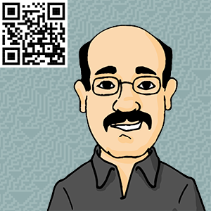
Jeff Heaton
Data Scientist, RGA
PhD Student, Computer Science
Author
jheaton@rgare.com

Slide 3

What is Data science?
Drew Conway’s Venn Diagram
Hacking Skills, Statistics & Real World Knowledge

Slide 4



My Books
Artificial Intelligence for Humans (AIFH)

Slide 5
Where to Get The Code?
All links are at my blog: http://www.jeffheaton.com
All code is at my GitHub site: https://github.com/jeffheaton/aifh
See AIFH volumes 1&3
My Github Page

Slide 6
What is Machine Learning
Making sense of potentially huge amounts of data
Models learn from existing data to make predictions with new data.
Clustering: Group records together that have similar field values. Often used for recommendation systems. (e.g. group customers with similar buying habits)
Regression: Learn to predict a numeric outcome field, based on all of the other fields present in each record. (e.g. predict a student’s graduating GPA)
Classification: Learn to predict a non-numeric outcome field. (e.g. predict the field of a student’s first job after graduation)
Machine Learning & Data Science

Slide 7
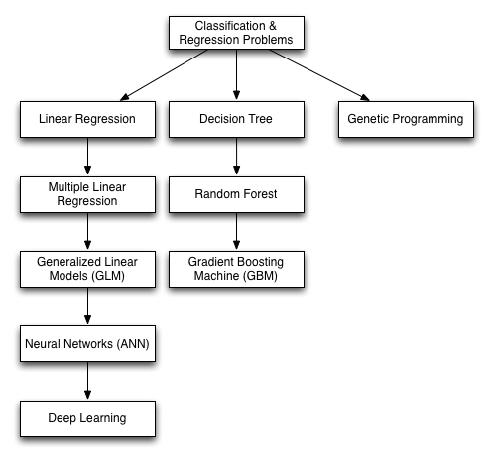
Evolution of ML
From Simple Models to State of the Art

Slide 8
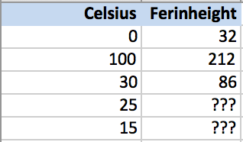
Supervised Training
Learning From Data

Slide 9
Conversion
class FahrenheitToCelsius {
public static void main(String[] args) {
double temperatue;
Scanner in = new Scanner(System.in);
System.out.println("Enter temperature
in Celsius: ");
temperature = in.nextInt();
temperatue = (temperatue*1.8)+32;
System.out.println("Temperature
in Fahrenheit = " + temperatue);
in.close();
}
}
Simple Linear Relationship

Slide 10
Regression
public static double regression(double x) {
return (x*1.8)+32;
}
public static void main(String[] args) {
double temperature;
Scanner in = new Scanner(System.in);
System.out.println("Enter temperature
in Celsius: ");
temperatue = in.nextInt();
System.out.println(
"Temperature in Fahrenheit = "
+ regression(temperature) );
in.close();
}
Simple Linear Relationship

Slide 11
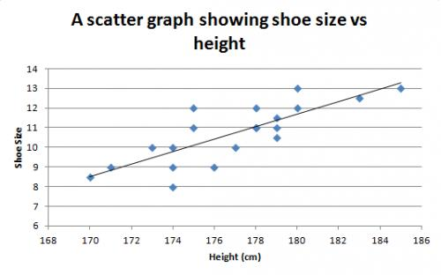
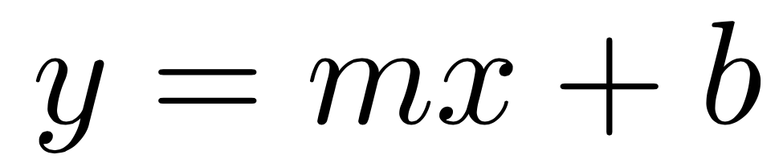
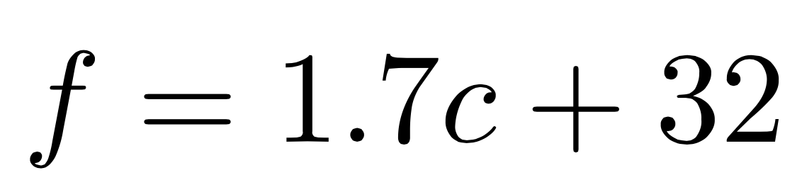
Linear Regression
Simple linear relationship
Shoe size predicted by height
Fahrenheit from Celsius
Must fit a line
Simple linear relationship
Shoe size predicted by height
Fahrenheit from Celsius
Two coefficients (or parameters) Many ways to get parameters.
Simple Linear Relationship

Slide 12
Multiple Regression
public double regression(double[] x,
double[] param) {
double sum = 0;
for(int i=0;i<x.length;i++) {
sum+=x[i]*param[i+1];
}
sum+=param[0];
return sum;
}
x[0] = in.nextInt();
double[] param = { 32, 1.8 };
System.out.println(regression(x,param));
Multiple Inputs

Slide 13
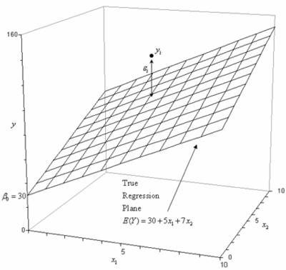
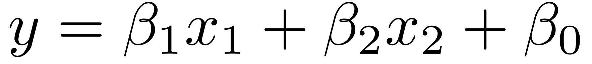
MUlti-Linear Regression
What if you want to predict shoe size based on height and age?
x₁ = height, x₂ = age,
determine the betas.
3 parameters
Higher Dimension Regression

Slide 14
GLM
public static double sigmoid(double x) {
return 1.0 / (1.0 + Math.exp(-1 * x));
}
public static double regression(double[] x,
double[] param) {
double sum = 0;
for (int i = 0; i < x.length; i++) {
sum += x[i] * param[i + 1];
}
sum += param[0];
return sigmoid(sum);
}
Generalized Linear Regression

Slide 15
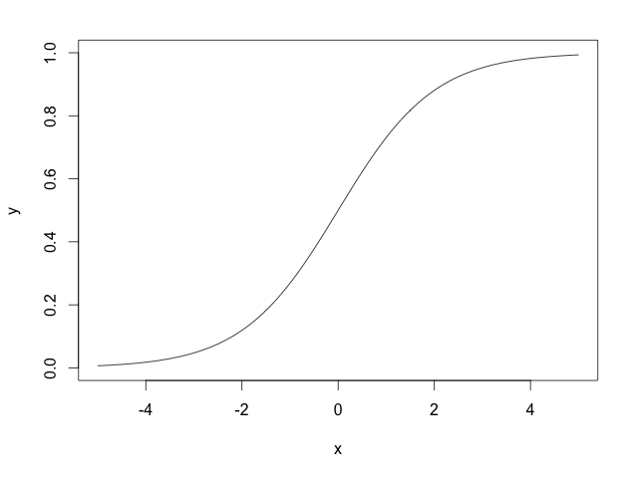
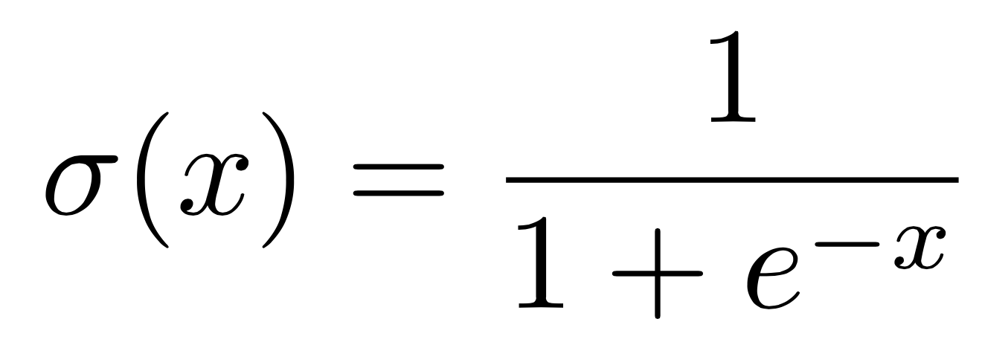
Sigmoid Function
S-Shaped Curve

Slide 16
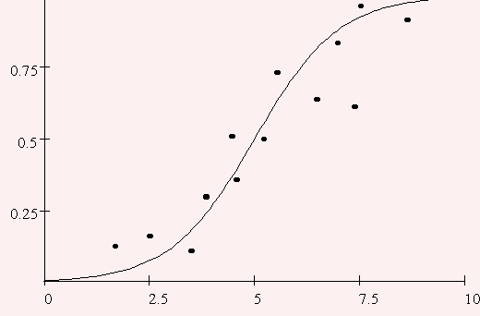
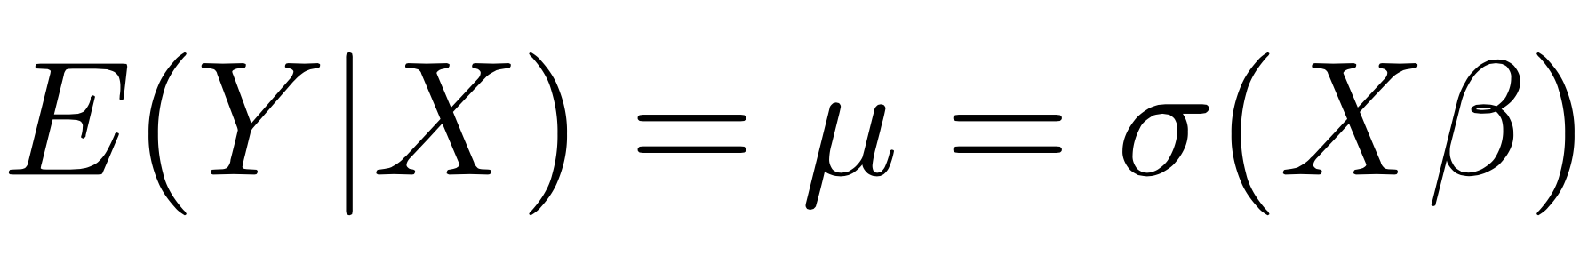
GLM
Linear regression using a link function
Essentially a single layer neural network.
Link function might be sigmoid or other.
Generalized Linear Model

Slide 17
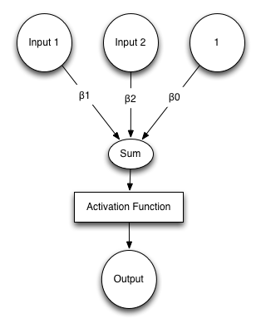
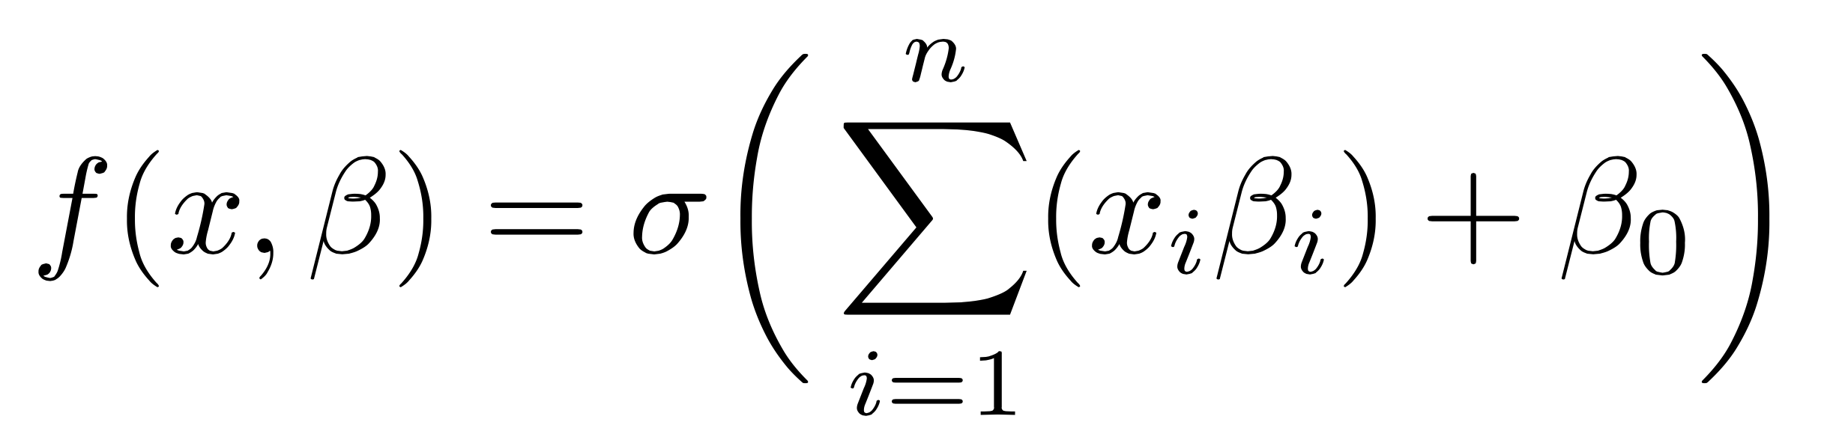
Neural Network
Multiple inputs (x)
Weighted inputs are summed
Summation + Bias fed to activation function (GLM)
Bias = Intercept
Activation Function = Link Function
Artificial Neural Network (ANN)

Slide 18
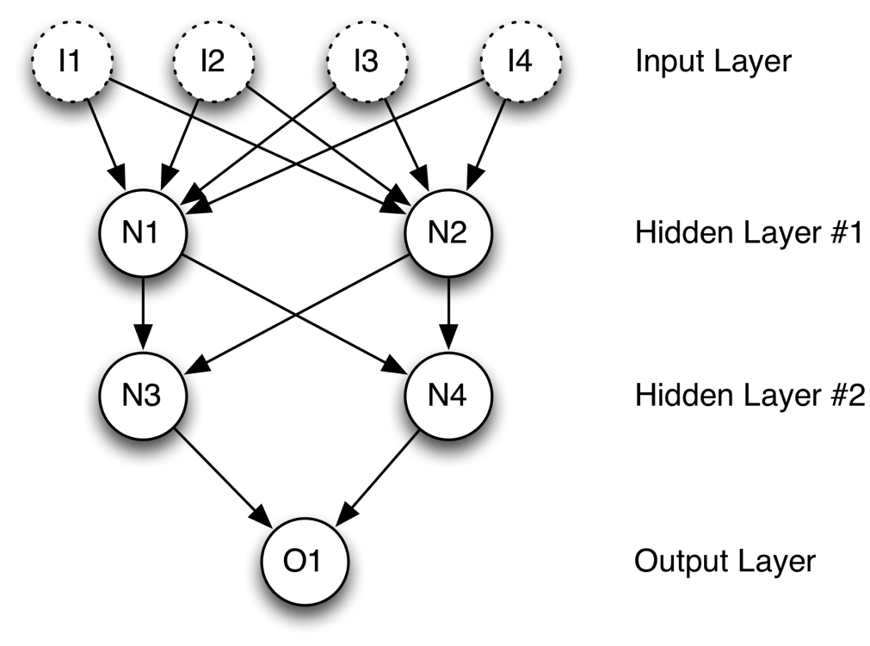
Multi-Layer ANN
Multiple layers can be formed
Neurons receive their input from other neurons, not just inputs.
Multiple Outputs
Neural Network with Several Layers

Slide 19
Training/Fitting
Differentiable or non-differentiable?
Gradient Descent
Genetic Algorithms
Simulated Annealing
Nelder-Mead
How do we find the weights/coefficient/beta values?

Slide 20
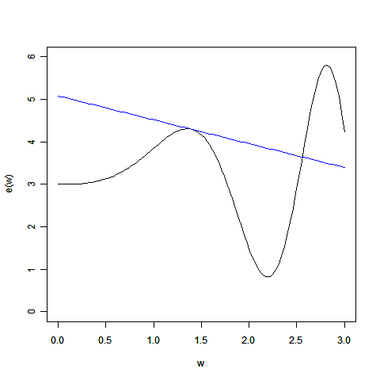
gradient Descent
Loss function must be differentiable
Combines the best of ensemble tree learning and gradient descent
One of the most effective machine learning models used on Kaggle
Finding Optimal Weights

Slide 21
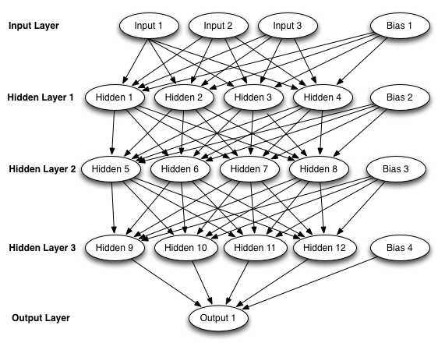
Deep Learning
Neural Network Trying to be Deep

Slide 22
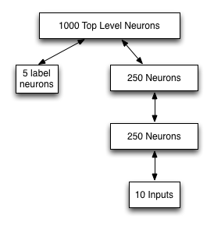
Deep Learning
Finding Optimal Weights

Slide 23
Deep Learning
Deep learning layers can be trained individually. Highly parallel.
Data can be both supervised (labeled) and unsupervised.
Feature vector must be binary.
Very often used for audio and video recognition.
Overview

Slide 24

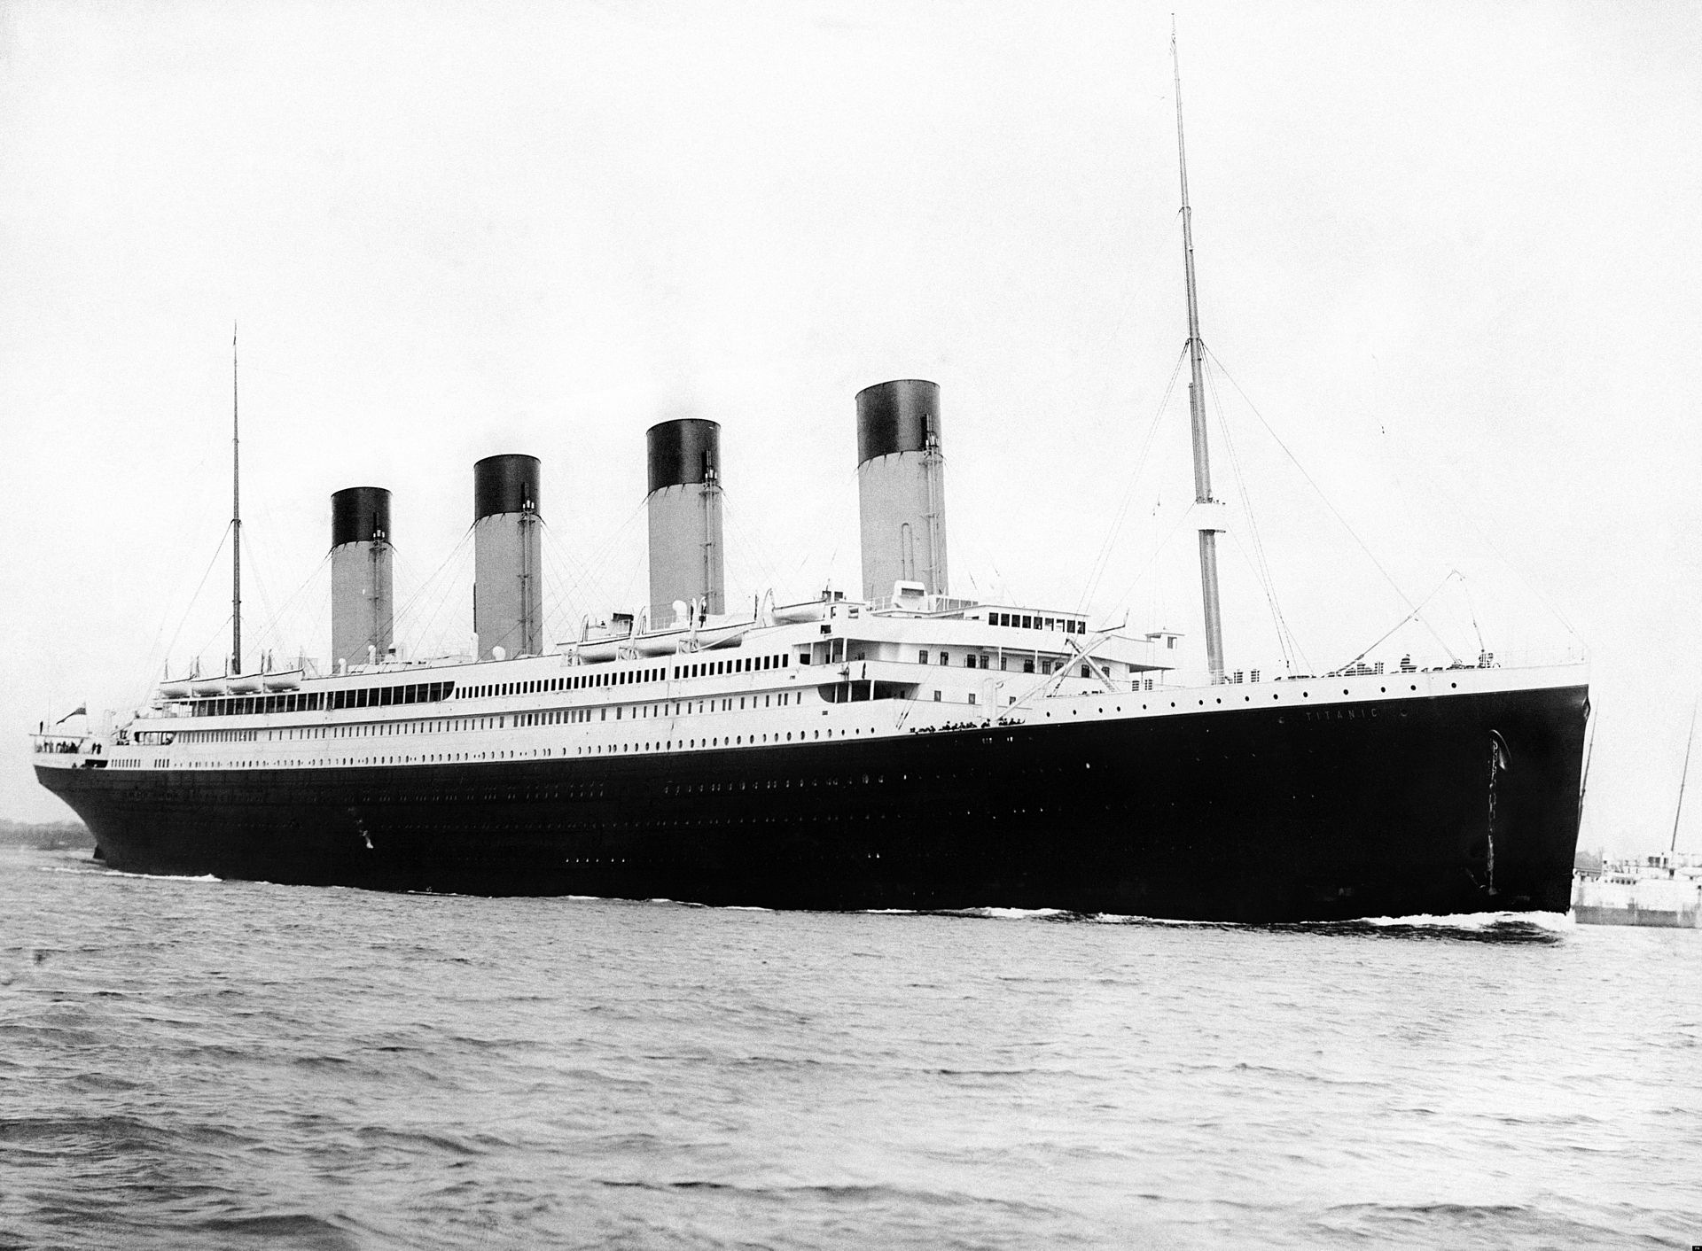
Case Study: Titanic
Predict the outcome:
Survived
Perished
From passenger features:
Gender
Name
Passenger class
Age
Family members present
Port of embarkation
Cabin
Ticket
Kaggle tutorial competition.

Slide 25

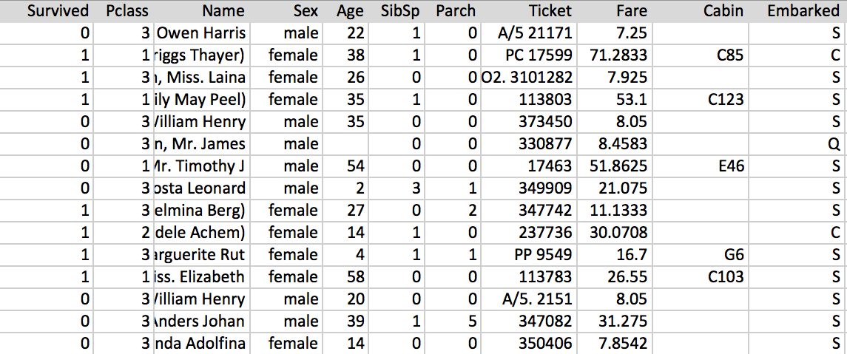
Titanic Passenger Data
Can you predict the survival (outcome) of a Titanic passenger, given these attributes (features) of each passenger?

Slide 26
Insights into Data
Is the name field useful?
Can it help us guess passengers with no age?
Moran, Mr. James
Williams, Mr. Charles Eugene
Emir, Mr. Farred Chehab
O'Dwyer, Miss. Ellen "Nellie"
Todoroff, Mr. Lalio
Spencer, Mrs. William Augustus (Marie Eugenie)
Glynn, Miss. Mary Agatha
Moubarek, Master. Gerios
Is the name field useful? Can it help us extrapolate ages?

Slide 27
Title Insights
Other passengers of the Titanic.
Carter, Rev. Ernest Courtenay
Weir, Col. John
Minahan, Dr. William Edward
Rothes, the Countess. of (Lucy Noel Martha Dyer-Edwards)
Crosby, Capt. Edward Gifford
Peuchen, Major. Arthur Godfrey
Sagesser, Mlle. Emma
Beyond age, what can titles tell us about these passengers?

Slide 28
Baseline Titanic Stats
Passengers in Kaggle train set: 891
Passengers that survived: 38%
Male survival: 19%
Female survival: 74%
These stats form some baselines for us to compare with other potentially significant features.

Slide 29
Title’s Affect Survival
 | # | Survived | Male Survived | Female Survived | Avg Age
Master | 76 | 58% | 58%
Mr. | 915 | 16% | 16%
Miss. | 332 |  |  | 71% | 21.8
Mrs. | 235 |  |  | 79% | 36.9
Military | 10 | 40% | 40% |  | 36.9
Clergy | 12 | 0% | 0% |  | 41.3
Nobility | 10 | 60% | 33% | 100% | 41.2
Doctor | 13 | 46% | 36% | 100% | 43.6
The titles of passengers seemed to affect survival.
Baseline male: 38%, female: 74%.

Slide 30
Departure & Survival
 | # | Survived | Male Survived | Female Survived
Queenstown | 77 | 39% | 7% | 75%
Southampton | 664 | 33% | 17% | 68%
Cherbourg | 168 | 55% | 30% | 88%
The departure port seemed to affect survival.
Baseline male: 38%, female: 74%.

Slide 31
Outliers: Lifeboat #1
4th lifeboat launched from the RMS Titanic at 1:05 am
The lifeboat had a capacity of 40, but was launched with only 12 aboard
10 men, 2 women
Lifeboat #1 caused a great deal of controversy
Refused to return to pick up survivors in the water
Lifeboat #1 passengers are outliers, and would not be easy to predict
We should not attempt to predict outliers. Perfect scores are usually bad. Consider Lifeboat #1.

Slide 32
Titanic Model Strategy
Use both test & train sets for extrapolation values.
Use a feature vector including titles.
Use 5-fold cross validation for model selection & training.
Model choice RBF neural network.
Training strategy: particle swarm optimization (PSO)
Submit best model from 5 folds to Kaggle.
This is the design that I used to submit an entry to Kaggle.

Slide 33

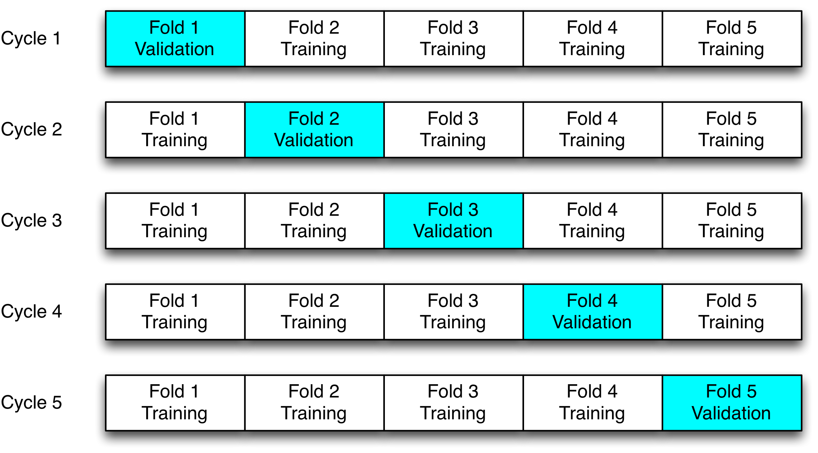
Crossvalidation
Cross validation uses a portion of the available data to validate out model. A different portion for each cycle.

Slide 34
My Feature Vector
Age: The interpolated age normalized to -1 to 1.
Sex-male: The gender normalized to -1 for female, 1 for male.
Pclass: The passenger class [1-3] normalized to -1 to 1.
Sibsp: Value from the original data set normalized to -1 to 1.
Parch: Value from the original data set normalized to -1 to 1.
Fare: The interpolated fare normalized to -1 to 1.
Embarked-c: The value 1 if the passenger embarked from Cherbourg, -1 otherwise.
Embarked-q: The value 1 if the passenger embarked from Queenstown, -1 otherwise.
Embarked-s: The value 1 if the passenger embarked from Southampton, -1 otherwise.
Name-mil: The value 1 if passenger had a military prefix, -1 otherwise.
Name-nobility: The value 1 if passenger had a noble prefix, -1 otherwise.
Name-Dr.: The value 1 if passenger had a doctor prefix, -1 otherwise.
Name-clergy: The value 1 if passenger had a clergy prefix, -1 otherwise.
These are the 13 features I used to encode for Kaggle.

Slide 35
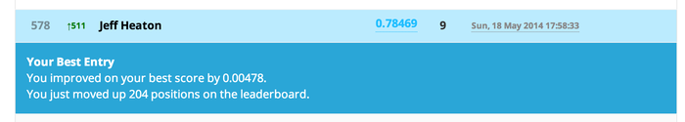
Submitting to Kaggle
This is the design that I used to submit an entry to Kaggle.

Slide 36
Other Resources
Microsoft Azure Machine Learning
http://azure.microsoft.com/en-us/services/machine-learning/
Johns Hopkins COURSERA Data Science
https://www.coursera.org/specialization/jhudatascience/1
KDNuggets
http://www.kdnuggets.com/
R Studio
http://www.rstudio.com/
CARET
http://cran.r-project.org/web/packages/caret/index.html
scikit-learn
http://scikit-learn.org/stable/
Here are some web resources I’ve found useful.

Slide 37
Thank you
www.jeffheaton.com
Any questions?

